Slide 1
Prenatal Health – Can Data predict it?
Jaini Desai
ENTITY ACADEMY

Slide 2
WHO are WE?
Mother & Me
Prenatal, Postnatal and Fetal health
We ensure that GOOD care is continued before, during, and After
We want to revolutionize Maternal and Fetal care to make it Preventative care instead of Treatment base

Slide 3
AGENDA
Introduction​
Primary goals
​Reason behind the analysis
Results
​Struggles
Questions

Slide 4
PRIMARY GOALS
Test the Hypothesis
Find a solution for bettering prenatal health
Decreasing fetal health complications

Slide 5
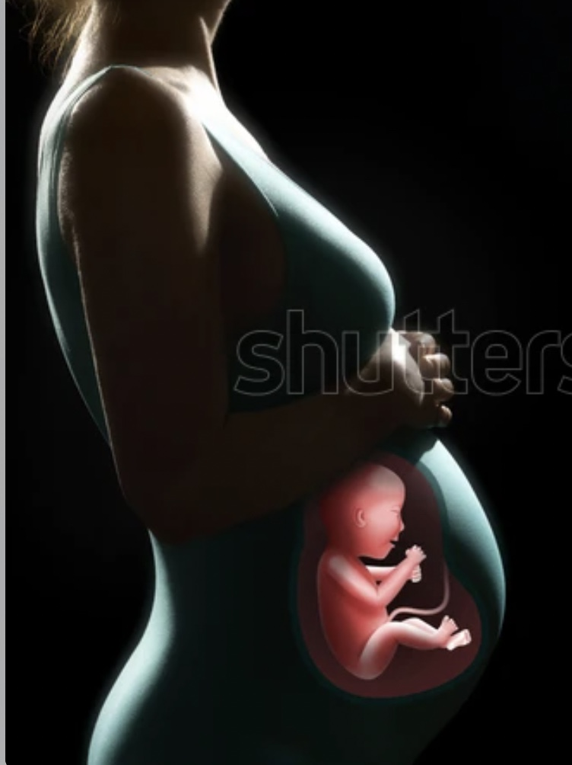
Gestational Diabetes - A View
What is Gestational Diabetes ?
When is it Diagnosed?
Who is diagnosed with it mostly?
How is it treated and monitored?
Why is it so important?
Where can WE help?
Notes:
What – Diabetes that you get when you are pregnant. It happens due to the shift in maternal hormones making the body unable to use insulin properly and increasing the blood sugar levels
When – It is usually diagnosed between 20-25 weeks depending on the guideline of the country
Who – Women of different descents especially women from the Asian, African, Hawaiian descent who seem to have a greater risk of having gestational diabetes (GDM)(affects 2-10%)
How – it can be managed by low-carb/sugar diet and exercise and if still not being able to maintain the standards of sugar than insulin is advised
Why – 50% of the women get lifetime type-2 diabetes later in life and children born to a mother with gestational diabetes are 6 times more prone to have diabetes later in childhood or earlier adulthood
Where – Mother and Me is an organization that wants to understand the patterns and which variables/factors affect the women’s health for them to get GD so we can predict the likelihood to maintain and monitor before the 20 weeks mark.

Slide 6
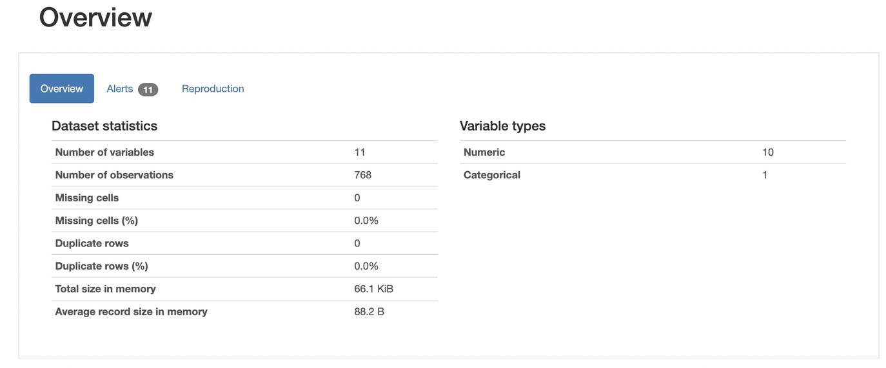
AREAS OF FOCUS
Data
Data STATS
Kaggle.com
PIMA Indian Diabetes Data
Women from PIMA region in USA, tribal community
Robust data with many variables
Has the potential to retrieve many different analysis

Slide 7
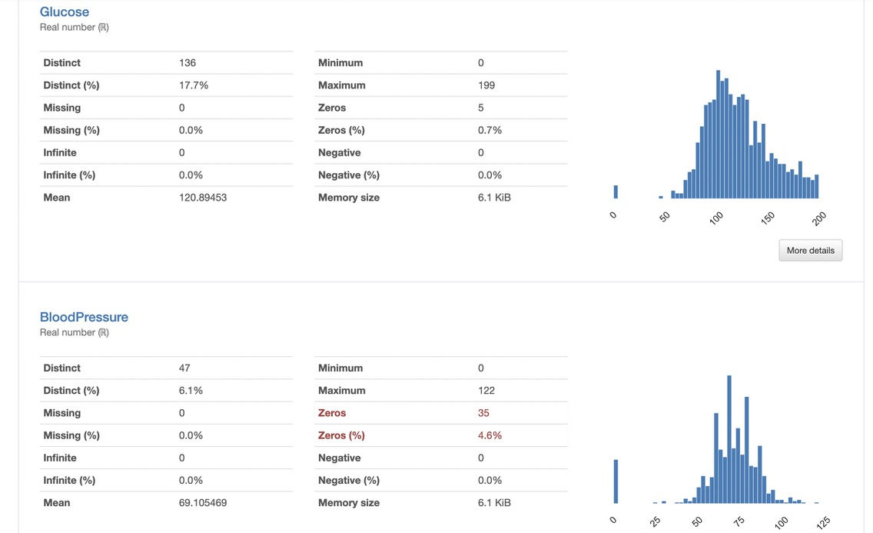
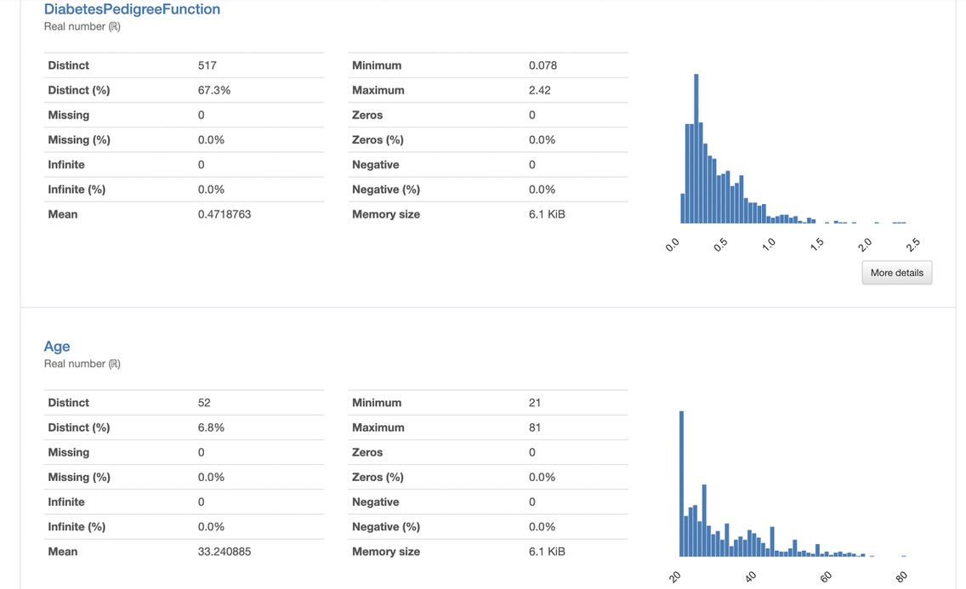
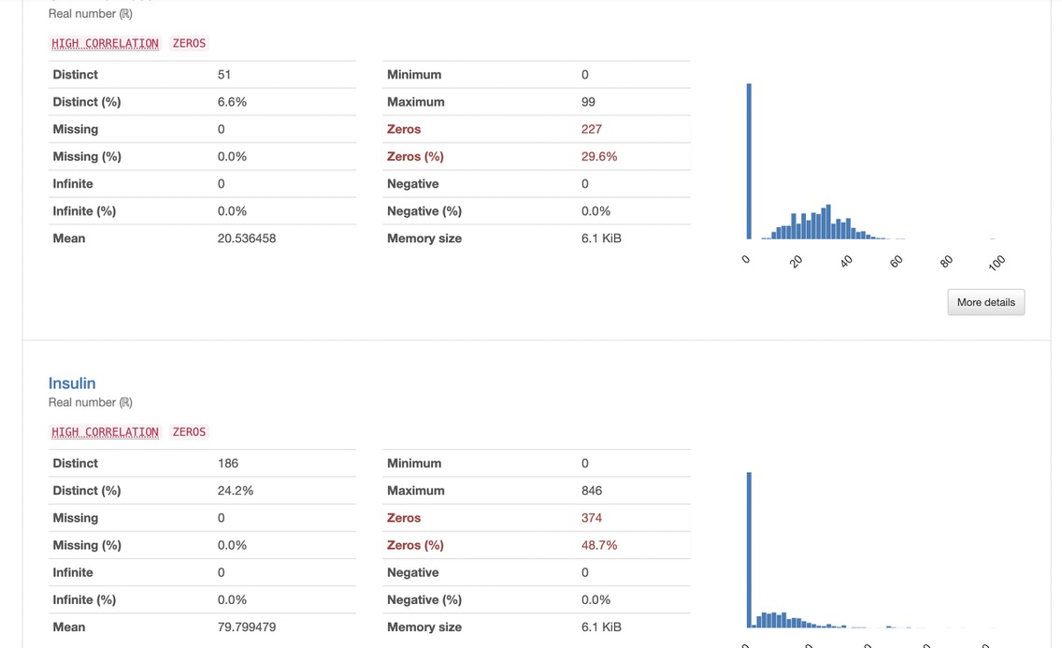
Variables

Slide 8
VARIABLES Chosen
HYPOTHESIS
QUESTION 1
The number of pregnancies affects the Outcomes and Blood Pressure in a positive correlation. The higher the number of pregnancy the greater the chances of one having diabetes and have higher Blood Pressure
QUESTION 2
The Age of the women along with their diabetes pedigree function affects their outcome of being diagnosed with GD
Number of Pregnancies
Outcome
Age
Diabetes Pedigree Function
Blood Pressure

Slide 9





HOW DID WE GET THERE
Ancova
Independent Chi-Sq
Logistic Regression
regression(correlation) model to understand how strong(accurate) the prediction model can be made
Between Continuous IV(age, and diabetes pedigree function) and a categorical DV (outcome)
Analysis of Covariance
Categorical IV and Continuous DV
Type 3 errors are used
Number of Pregnancies (IV) vs Blood Pressure and Diabetes Pedigree Function (DV) as a co-variant
Analyzing relationship between the means of two categorical variables
Number of Pregnancies (IV)
Outcome (DV)

Slide 10
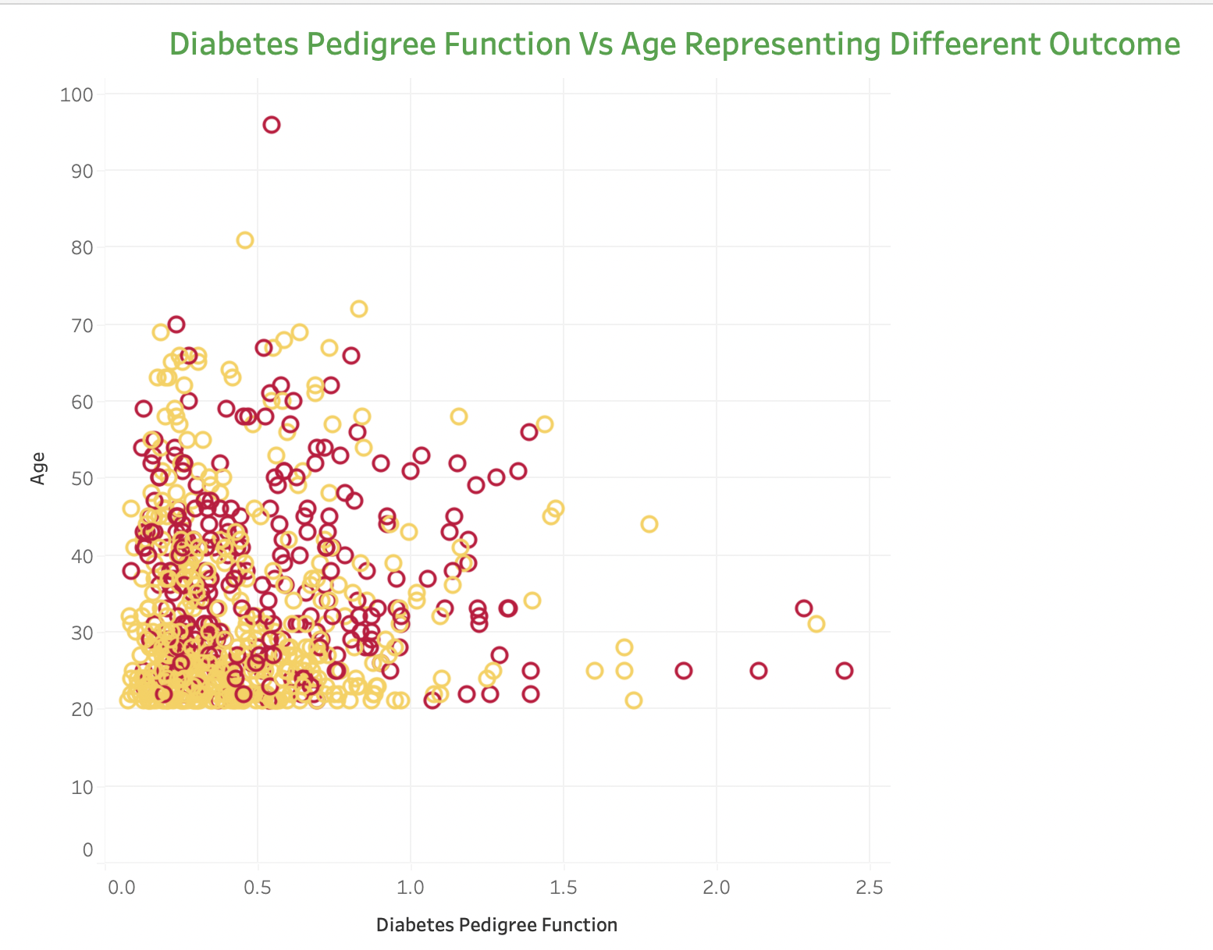
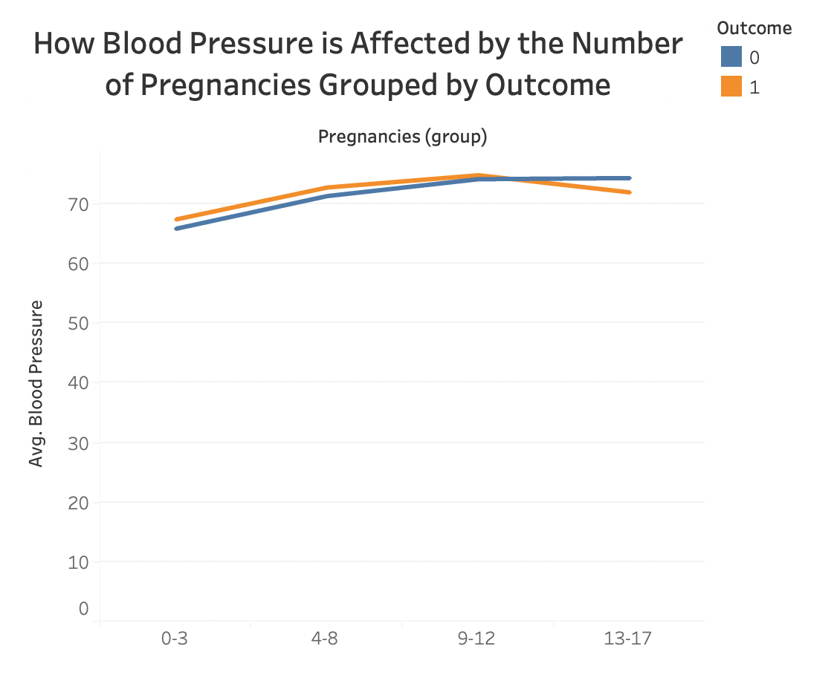

Overview of the variables

Slide 11
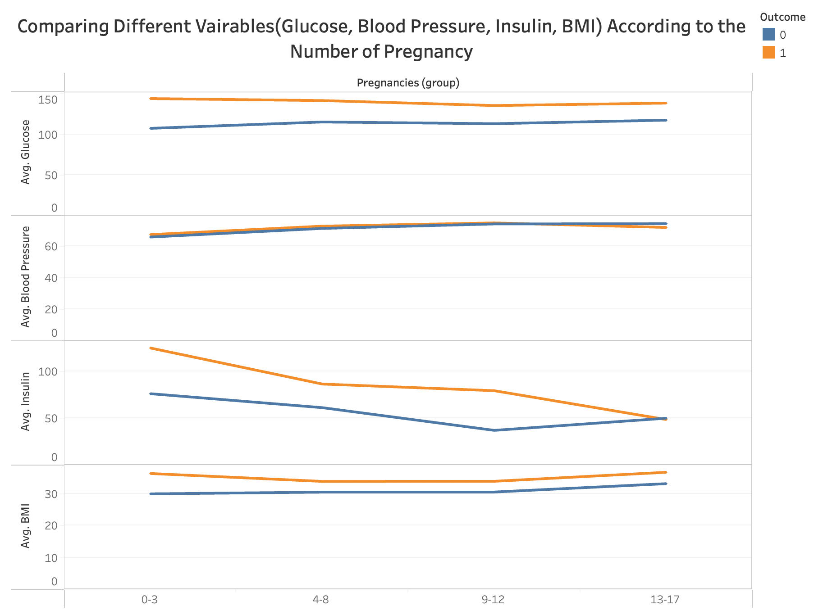
Continued…

Slide 12
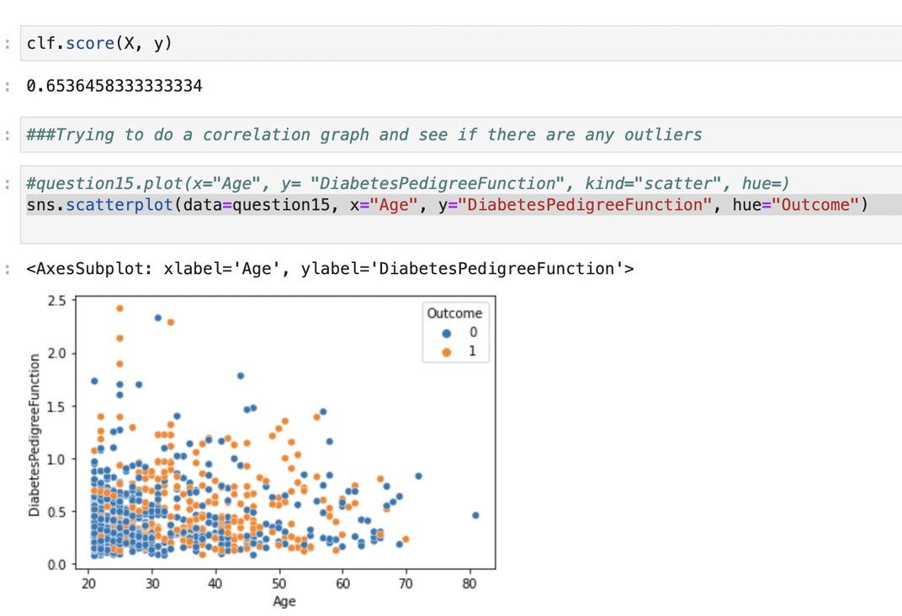
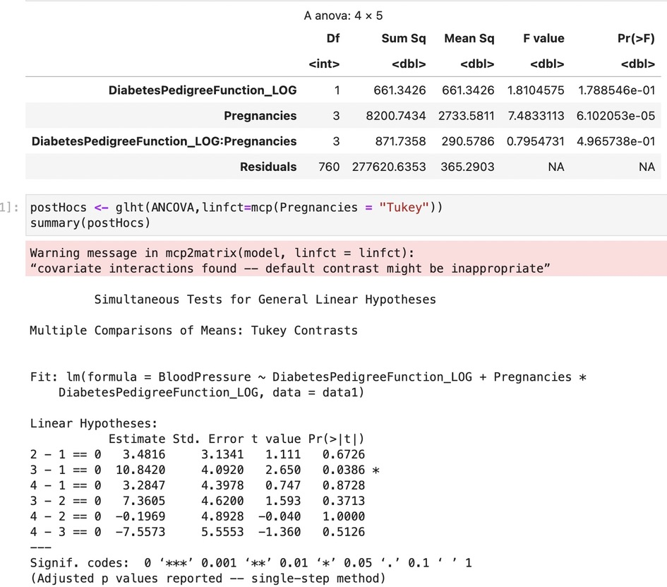
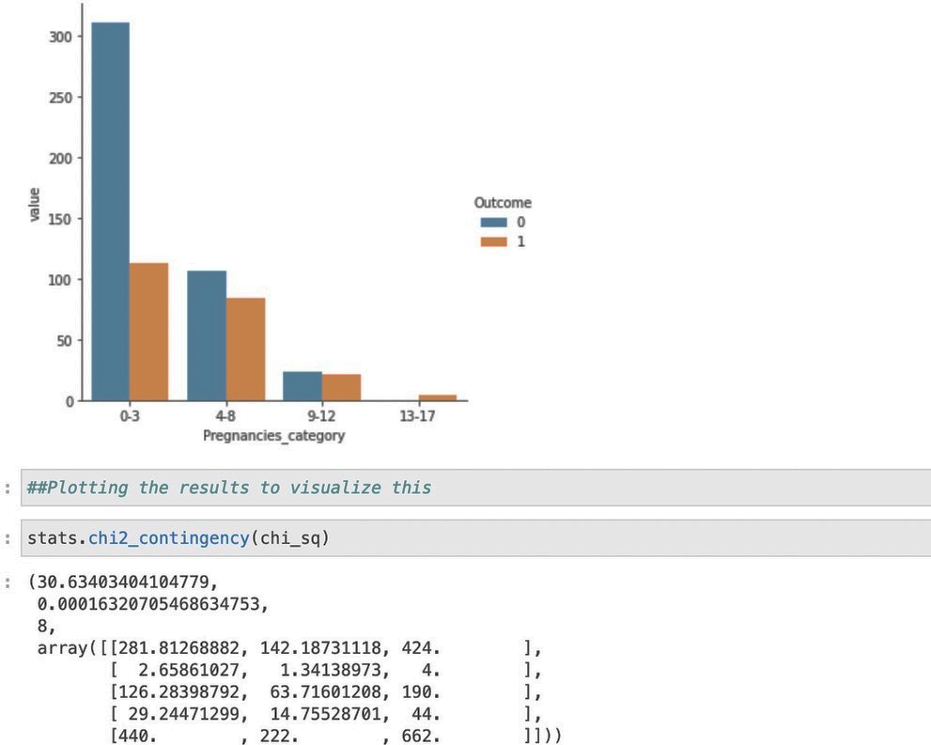
Results
Logistic Regression
ANCOVA
Independent Chi-Sq

Slide 13
WHAT DOES THIS MEAN?
QUESTION 1
Divided into Independent Chi-sq and ANCOVA
Number of Pregnancies vs Outcome- Hypothesis Accepted
Number of Pregnancies vs Blood Pressure and Diabetes Pedigree Function as a Co-Variance- Hypothesis Accepted
Question 2
Logistic Regression
The Age of the Pregnant women along with their Diabetes Pedigree Function score vs their Outcome
Hypothesis Accepted - 65% accurate model WITHOUT removing outliers

Slide 14

WHAT did we learn?
All the variable are heavily correlated with the outcome
Its hard to understand the predictability of the model without doing a thorough stepwise regression of ALL the variables present

Slide 15

STRUGGLES OR CHALLENGES
ANCOVA TEST
Finding Co-Variance
Post Hoc Tests
Outliers in Logistic Regression model
Time lines
Dividing tasks

Slide 16
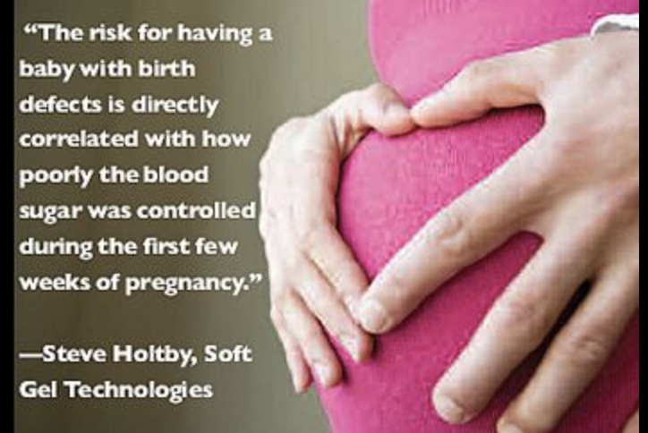
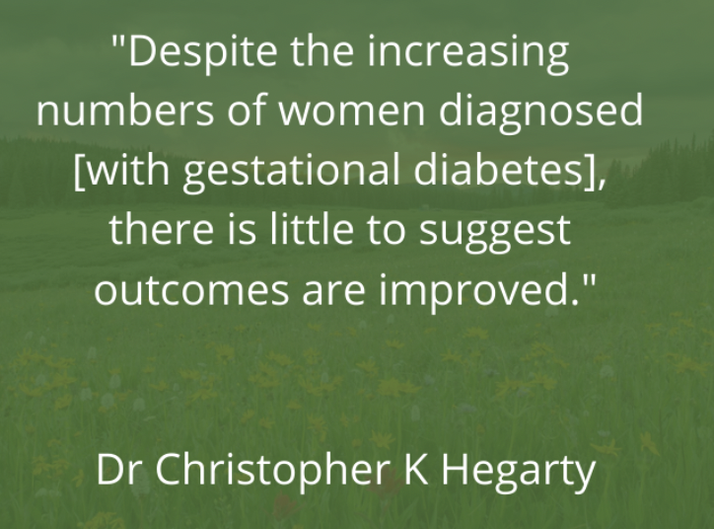
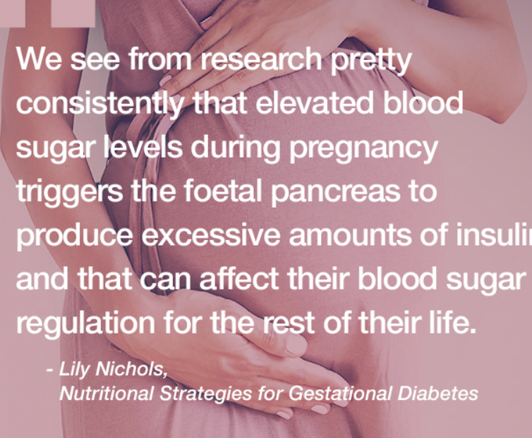
Some Thoughts

Slide 17

THANK YOU

